Slide 1


Crash on Titan
Victor Breda
Paula-Alexandra Gitu
Tobias Mersch
Joep Muijrers
Valentin Ringlet
Roy Withaar
Project 1.2, Presentation Second Phase

Slide 2
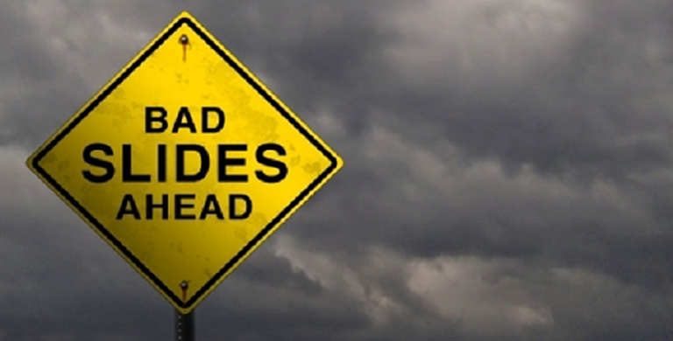

Slide 3

Solar System Improvement
Fourth-order Runge-Kutta method
Replaced the phase 1 Euler’s method
More text
More text

Slide 4
Motion of Landing
Fucking rotating rectangle

Slide 5
Controllers for Landing
Feedback Controller
More text
More text
More text

Slide 6
Controllers for Landing
Open Loop Controller
More text
More text
More text

Slide 7
Experiments

Slide 8
Phase 3 Schedule

Slide 9
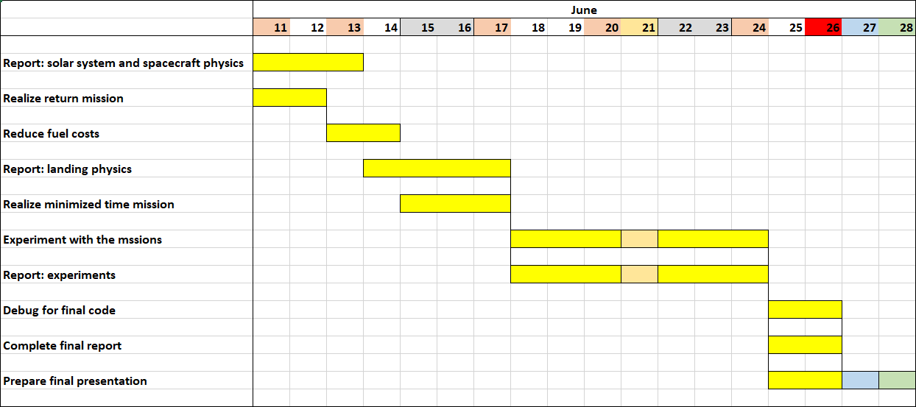
Phase 3 Schedule

Slide 10



